Slide 1
DDOS TRAFFIC DETECTION using deep learning
Submitted By:
PUNEET GUPTA (102116073)
GAUTAM OBEROI( 102116095)

Slide 2
Introduction
Overview of the project and its purpose
This project aims to develop an DDOS traffic detection tool.
The purpose of this tool is to enhance DDoS attack detection accuracy and generalizability using deep learning techniques.
The need for an DDOS traffic detection tool
The need for DDoS traffic projects using deep learning stems from the increasing sophistication and frequency of Distributed Denial-of-Service (DDoS) attacks. These attacks aim to overwhelm a targeted network or server with excessive traffic, rendering it inaccessible to legitimate users. Traditional DDoS detection methods, such as signature-based and statistical approaches, are struggling to keep pace with the evolving attack landscape. Deep learning offers a promising solution to address this challenge by enabling the development of more accurate and generalizable detection systems.

Slide 3
WHAT IS MEANT BY DDOS?
DDoS stands for Distributed Denial-of-Service attack. It is a type of cyberattack that aims to make a server or network resource unavailable to users, usually by overwhelming the target with a flood of requests. This can be done by using a large number of compromised computers or other devices to send requests to the target server or network. The result is that legitimate users are unable to access the target resource.
DDoS attacks can be very disruptive and can cause significant financial damage to businesses. They can also be used to launch other types of attacks, such as ransomware attacks

Slide 4
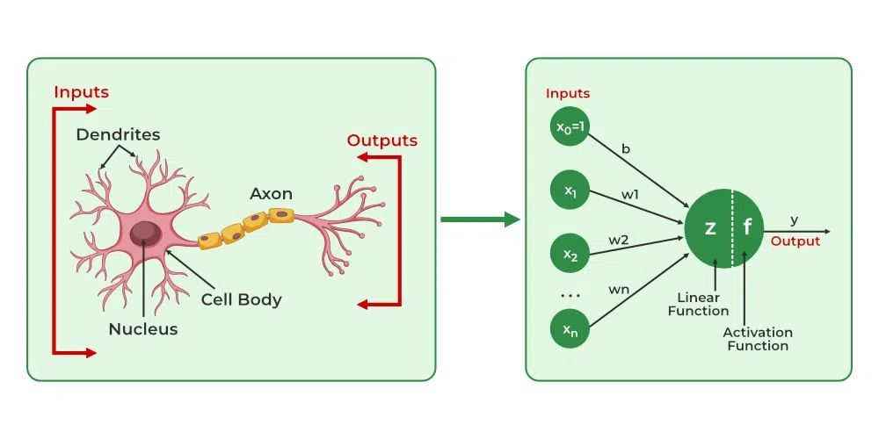
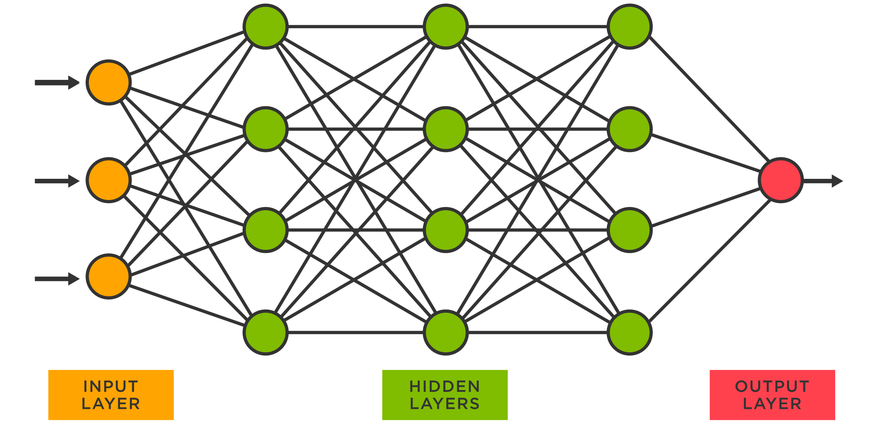
Neural Networks
Neural networks are a subset of machine learning algorithms inspired by the structure and functioning of the human brain. They are particularly well-suited for complex tasks involving large amounts of data, such as medical image analysis and pattern recognition. Neural networks can automatically learn patterns and features from input data, allowing them to make predictions and classifications based on learned relationships.

Slide 5
Benefits of using Neural network tools
The tool is faster than manual method for classification, so it saves time.
Neural networks can analyze network traffic in real time, enabling them to detect and respond to DDoS attacks as they occur.
Neural networks can learn complex patterns from large datasets of network traffic, enabling them to accurately distinguish between normal and malicious traffic.

Slide 6
Methodology
1. The steps involved in building the spam detection model:
Define the problem statement and gather relevant data
Choose the appropriate algorithm for classification
Train and test the model
Deploy and monitor the model
2. Importing relevant libraries for building the model:
Introduction to Python libraries used for building the model such as scikit-learn and pandas

Slide 7
3. Data preparation and cleaning:
Importing DDOS data which is dataset_sdn from pandas.
Exploratory data analysis to understand the data
Splitting the data into training and testing sets using test train split function from sklearn library.
4. Feature extraction and selection:
Transforming the raw text and categorical data into readable data frames using numpy as array function.
Selecting the most relevant features using some functions from libraries.

Slide 8
5. Model training and evaluation:
Create a Neural network using tensorflow and keras.we are creating 3 layers (30,20,2) input, hidden(neuron layer),output layer and here there are two output layers as we are classifying into two label.
Training the model on the training set
Evaluating the model's performance on the testing set using metrics like accuracy.
Fine-tuning the model for better performance.
6. Result :
classifies Benign and Malign as 1 and 0 respectively

Slide 9
KNN Classifier
K-Nearest Neighbor (K-NN) is one of the simplest Supervised Machine Learning algorithms which presumes the similarity between existing data and new data and put the new case into the category that is most like the available ones. It classifies a new data point based on the similarity of stored available data i.e., when any new data appears then it can be easily classified into a well-suited category by using K- NN algorithm. The KNN classifier has the ability to effectively detect invasive attacks as well as achieve a low fall-out ratio. It can distinguish between the normal and abnormal behavior of the system and is used to classify the status of networks to each phase of DDoS attack.

Slide 10
Stochastic Gradient Descent
This Classifier implements regularized linear models such as SVM, logistic regression, etc. by making use of Stochastic gradient descent (SGD) optimization technique in the training process. The gradient of the loss for each sample is calculated by this optimizer at a time and the model is updated by estimating minimum cost function which is obtained with a decreasing learning rate or strength schedule. SGD Classifier is an efficient estimator for large scale problems as it allows minibatch learning via the partial fit method. Simple linear classifiers don’t work if the records cannot be kept in RAM, however SGD classifier continues to work. This model is sensitive to feature scaling and require fine tuning of many hyperparameters such as number of iterations and regularization parameter for a good performance.

Slide 11
DECISION TREES CLASSIFIER
Decision Tree belong to the class of non-parametric supervised learning method. It is mainly used for the purpose of solving the regression and the classification problems. The major aim is to build a model which predicts the value of a target variable which is done by learning the simple decision tree rules that are inferred from the features of the data. The tree is seen as a piecewise constant approximation. For solving the classification problem, the class DecisionTreeClassifier is used. The class is well equipped to perform a multi-class classification on the dataset. The classifier takes two arrays as input: an array X or dense, having shape (n_samples, n_features) which hold the training samples of the dataset, and an array Y which have integer values having shape (n_samples) which hold the class labels of the corresponding training samples. After model fitting, the model is used for making predictions of class of the samples. In the case of multiple classes with the exact same and highest probability, the classifier tends to predict the class which has the lowest index among the classes. Besides outputting to a specific class, the probability of each class could be predicted which constitutes the fraction of the training sample of the class in a leaf. The classifier is capable for classifying both multi-class classification and binary lassification.

Slide 12
Deep Neural Networks
One of the most well-known and recent models is the Deep Neural network which can be considered as a stack of neural networks i.e., a network composed of several layers. DNN has been successfully applied in several applications, including regression, classification, or time series prediction problems using simple auto-regressive models. The architecture comprises of at least 3 layers of nodes namely input layer, hidden layer and output layer which are interconnected; the flow of data takes place via one direction from input nodes to output node. Further DNN uses backpropagation as the training algorithm and activation function (usually sigmoid) for classification process. We train a deep neural network to classify normal and DDoS attack states by using a carefully chosen set of network statistics as an input signal.

Slide 13
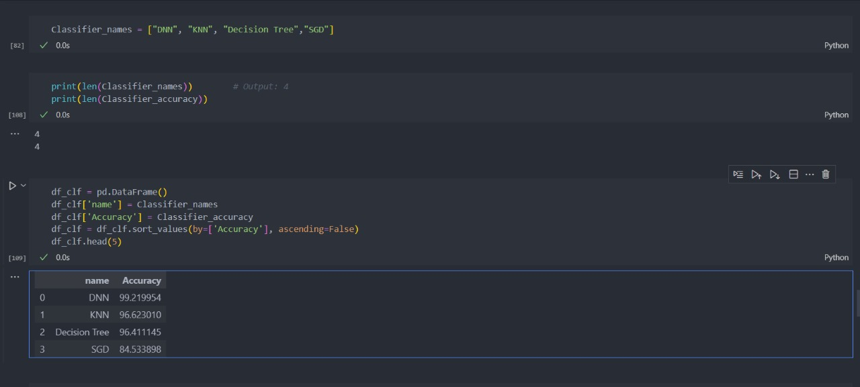
Final score comparison of all the models used
For Neural Network

Slide 14
bibliography
Deep neural network for ddos attacks articlehttps://ijai.iaescore.com/index.php/IJAI/article/view/20884Machine learning for ddos attacks _Detection_of_Different_DDoS_Attacks_Using_Machine_Learning_Classification_Algorithms
https://www.researchgate.net/publication/356465007

